Slide 1
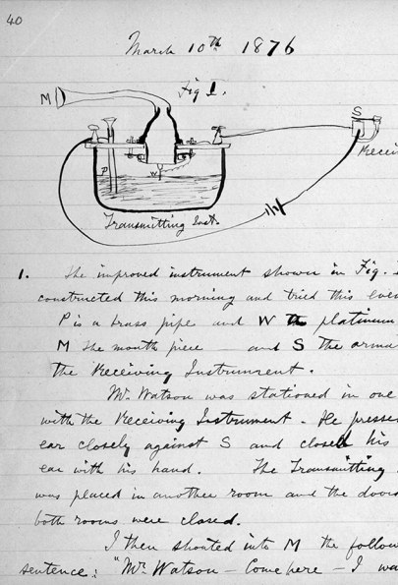
How to Keep a Good Lab Notebook
The 1876 notebook of Alexander Graham Bell,
who patented the first practical telephone.

Slide 2

Why is it Important to Keep a Good Laboratory Notebook?
Keeping a complete and accurate record of experimental methods and data is a vital part of science and engineering. Your laboratory notebook is a permanent record of what you did and what you observed in the laboratory. Learning to keep a good notebook now will establish good habits that will serve you throughout your career. Your notebook should be like a diary, recording what you do, and why you did it.
You should feel free to record your mistakes and difficulties performing the experiment - you will frequently learn more from these failures, and your attempts to correct them, than from an experiment that works perfectly the first time. It is extremely important that your notebook accurately record everything you did. A good test of your work is the following question: could someone else, with an equivalent technical background to your own, use your notebook to repeat your work, and obtain the same results?
For that matter, could you come back six months later, read your notes, and make sense of them? If you can answer yes to these two questions, you are keeping a good notebook.

Slide 3
Why is it Important to Keep a Good Laboratory Notebook?
The laboratory notebook forms a permanent record that can be referred to while completing a disclosure report (often the first step in patent preparation) and later, provides accurate documentation of the work done. When an investigator makes an invention during the course of a research project, the dates of the conception and reduction to practice (turning an idea into a reality) become very important. Generally, a sketch and a brief written description are sufficient to establish conception. Reduction to practice is accomplished by actually constructing and successfully testing a material or device incorporating the invention.
During prosecution of a patent application before the U.S. Patent Office, or even after issuance of a patent, the filing of another patent application may initiate an interference proceeding to determine which party was the first to invent. Each party has an opportunity to submit documentary proof of his or her dates of conception and reduction to practice. A laboratory notebook may be, and in several high-profile cases has been the crucial piece of evidence in this procedure.

Slide 4

Your lab notebook serves three important purposes:
A record of important procedures for experiments you have developed during your experimentation.
A record of the results of experiments that you have performed.
The means to reproduce the results of your experiments by following the procedures you have developed at another time or place
A good notebook is not simply a list of results of experiments but allows you to develop methods that you can use for further experimentation and would allow someone else to reproduce your results and understand why you did what you did in your experiments.

Slide 5
What goes into your notebook
Page numbers – if your notebook doesn’t already have them add them to the upper outside corner of each page. These are important so you can refer back to frequently used tables, procedures, or results. You can also be sure that there are no missing pages (leading to missing steps) if following a past procedure.
A table of contents – The first few pages should be reserved for this, it allows you to quickly find the information you are looking for and makes the book a useful reference. Later on you will be able to find a particular experiment without having to read every page.
Dates – Every entry, or at the very least every day that you record data should be dated, this allows you to find thingsmore easily.
Unusual conditions during an experiment – Sometimes things go differently than we plan and we have something unusual happen during our experiments some of the things you might want to look for and record are: Strong storms (ie. behavior of an observed animal may be atypical) Extremes in temperature or humidity (many instruments and materials are sensitive to temperature and humidity) Power failures (if your experiment requires power)

Slide 6
What goes into your notebook
Name of the corresponding files.
Something went wrong or was unexpected (ie. you notice that the apparatus is no longer working at some point during your experiment)
Experimenter fatigue may impair your ability to make good observations
Reasons for decisions made during an experiment – What we did isn’t always good enough, why we did what we did is just as important to record. Make sure that you record the whys and not just the whats. Contact information for people that provided you with information or supplies – They may be able to provide you with some materials in the future or to give you more information later on should you need it. It is important to give credit where it is due as well. Any information that you might need to reproduce the results of an experiment – Your notebook alone should be sufficient for someone to reproduce your experiment. Aim to be as complete as possible!

Slide 7




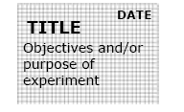
Rules for Maintaining your Laboratory Notebook
 | Leave several pages blank at the beginning for a Table of Contents and update it when you start each new experiment or topic
 | Always use pen and write neatly and clearly
 | Date every page on the top outside corner
 | Start each new topic (experiment, notes, calculation, etc.) on a right-side (odd numbered) page
 | Record the TITLE and OBJECTIVES of each experiment (or notes or calculations) at the top of the first page of the notebook dedicated to this topic.
 | .

Slide 8
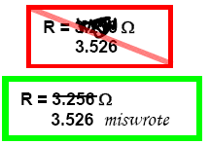
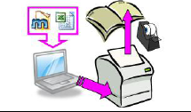
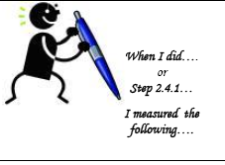
Rules for Maintaining your Laboratory Notebook
 | If you make a mistake, don’t obliterate it! You may need to read your mistake later – perhaps you were right the first time! Use a single cross out and EXPLAIN why it was an error.
 | Data typed into the computer must be printed and taped into your lab notebook. Plots of data made in lab should also be printed and taped in your lab notebook.
 | When you record an observation in your notebook, include an explanation of what you were doing at the time. If appropriate, you may just record the step number in the instructions followed by your observation

Slide 9
Rules for Maintaining your Laboratory Notebook
Metric | Requirements
Pen | Write in pen, not pencil
Date | Date every page at the top
Right Side | Begin each experiment on odd page
Printouts | Attach printouts and plots of data as needed
Legible | Obvious care taken to make it readable, even if you have bad handwriting
Mistakes | Mistakes crossed out with one line and explained
Organized | table of contents title of experiment on 1st page objectives of experiment clear from notebook what you were doing when
Informative | All required data and information Descriptive comments of your observations

Slide 10
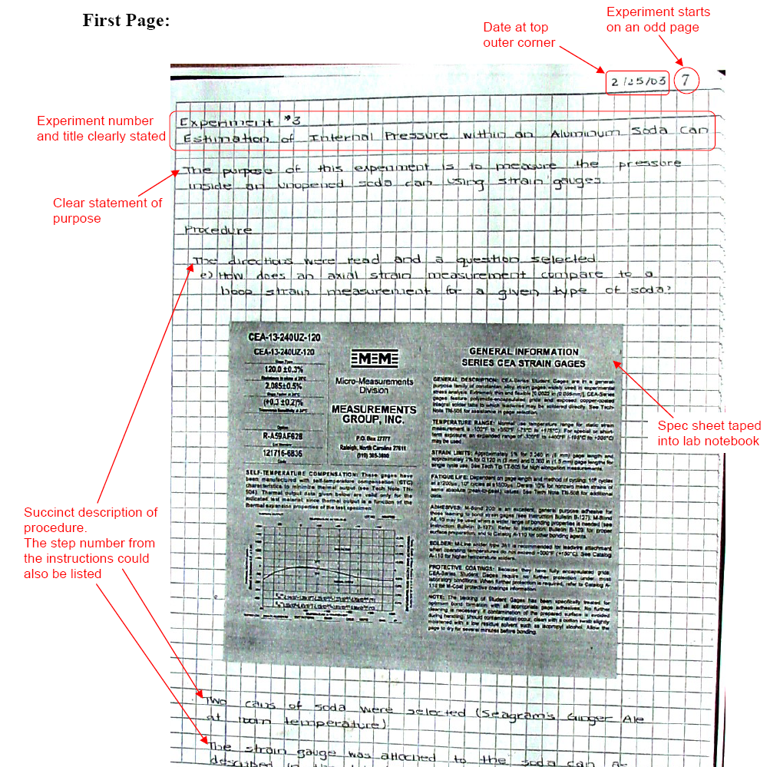
Example: Complete Experiment

Slide 11
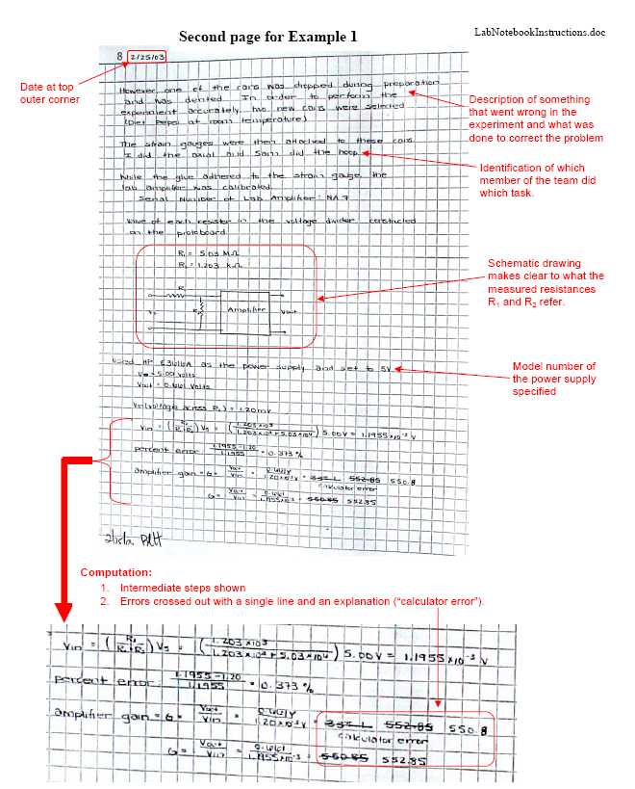
Example: Complete Experiment

Slide 12
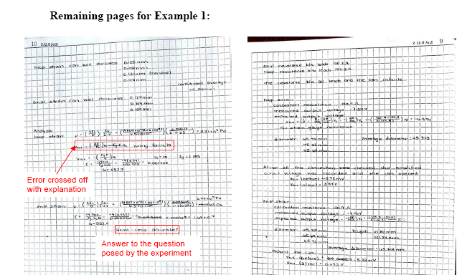

Slide 13
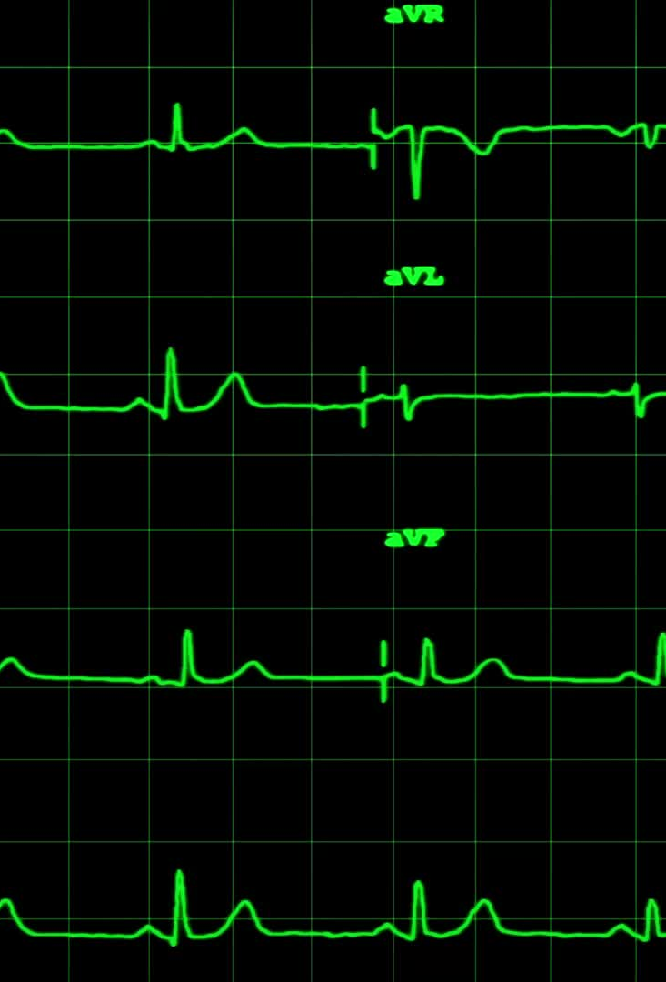
Key points in this example:
1. Neat and legible handwriting
2. Experiment title and purpose clearly stated
3. Procedure described clearly and succinctly, including errors and the steps taken to correct
them
4. Computations performed neatly showing intermediate steps
5. Errors crossed out with a single line and explained
6. All pages dated at the top and signed by lab professor on the same

Slide 14
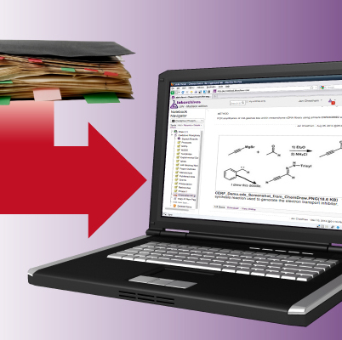
Electronic lab notebooks
Why OneNote, Word documents and pdfs are NOT acceptable lab notebooks

Slide 15

Why is OneNote not a good lab notebook
Lack of Compliance with Good Laboratory Practices (GLP) and Regulations
Many research institutions require lab notebooks to comply with regulations like FDA 21 CFR Part 11 (for electronic records) or GLP standards.
OneNote lacks built-in compliance features like timestamped, unalterable records or audit trails, making it unsuitable for legally defensible data management.
Inability to Properly Track Changes and Maintain Data Integrity
A good lab notebook must ensure that data cannot be deleted or modified without tracking.
OneNote allows users to edit, move, or delete content without an unalterable audit trail, which could compromise data integrity.
Lack of Secure Electronic Signatures
Proper electronic lab notebooks (ELNs) require secure, legally binding electronic signatures to verify and authenticate entries.
OneNote does not provide a certified signing mechanism that meets legal or regulatory requirements.
Poor Version Control and Backup for Scientific Integrity
Scientific work requires permanent records with proper version control.
OneNote lacks robust versioning and controlled backups, meaning accidental or intentional deletions may not be recoverable in a traceable way.
Not Designed for Experimental Data Management
OneNote is a general note-taking app, not designed to handle:
Structured scientific data entry
Integration with lab instruments
Metadata tagging
Sample tracking
Security and Confidentiality Concerns
Some research requires high-level security for intellectual property or sensitive data.
OneNote stores data in the cloud, which may not comply with institutional or legal data security policies (e.g., HIPAA, GDPR).

Slide 16
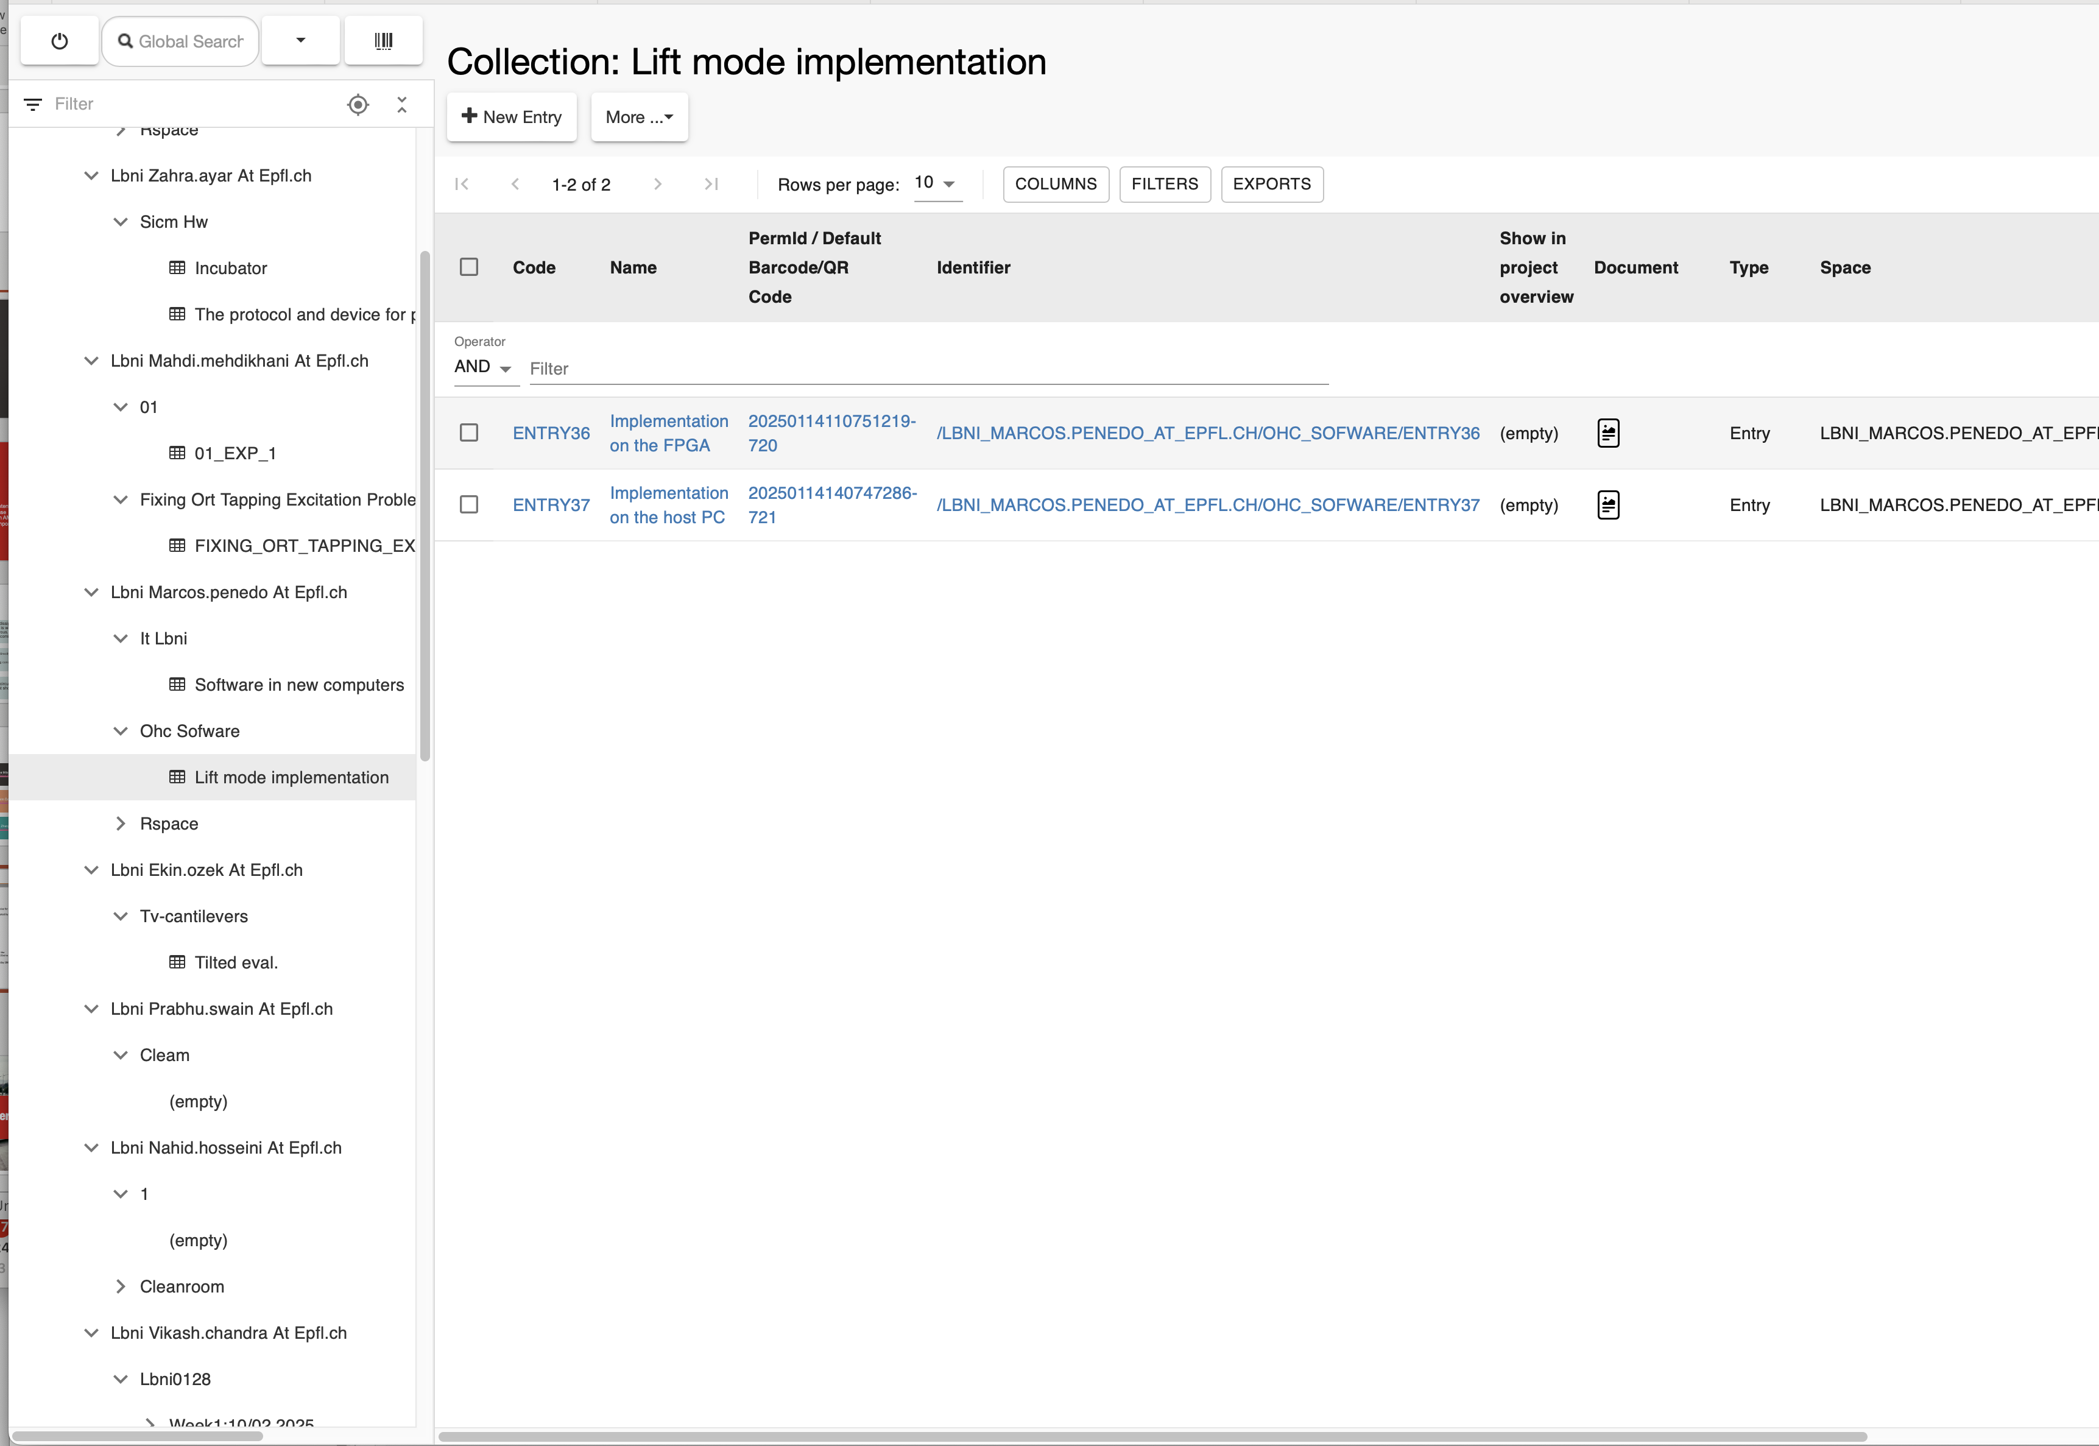
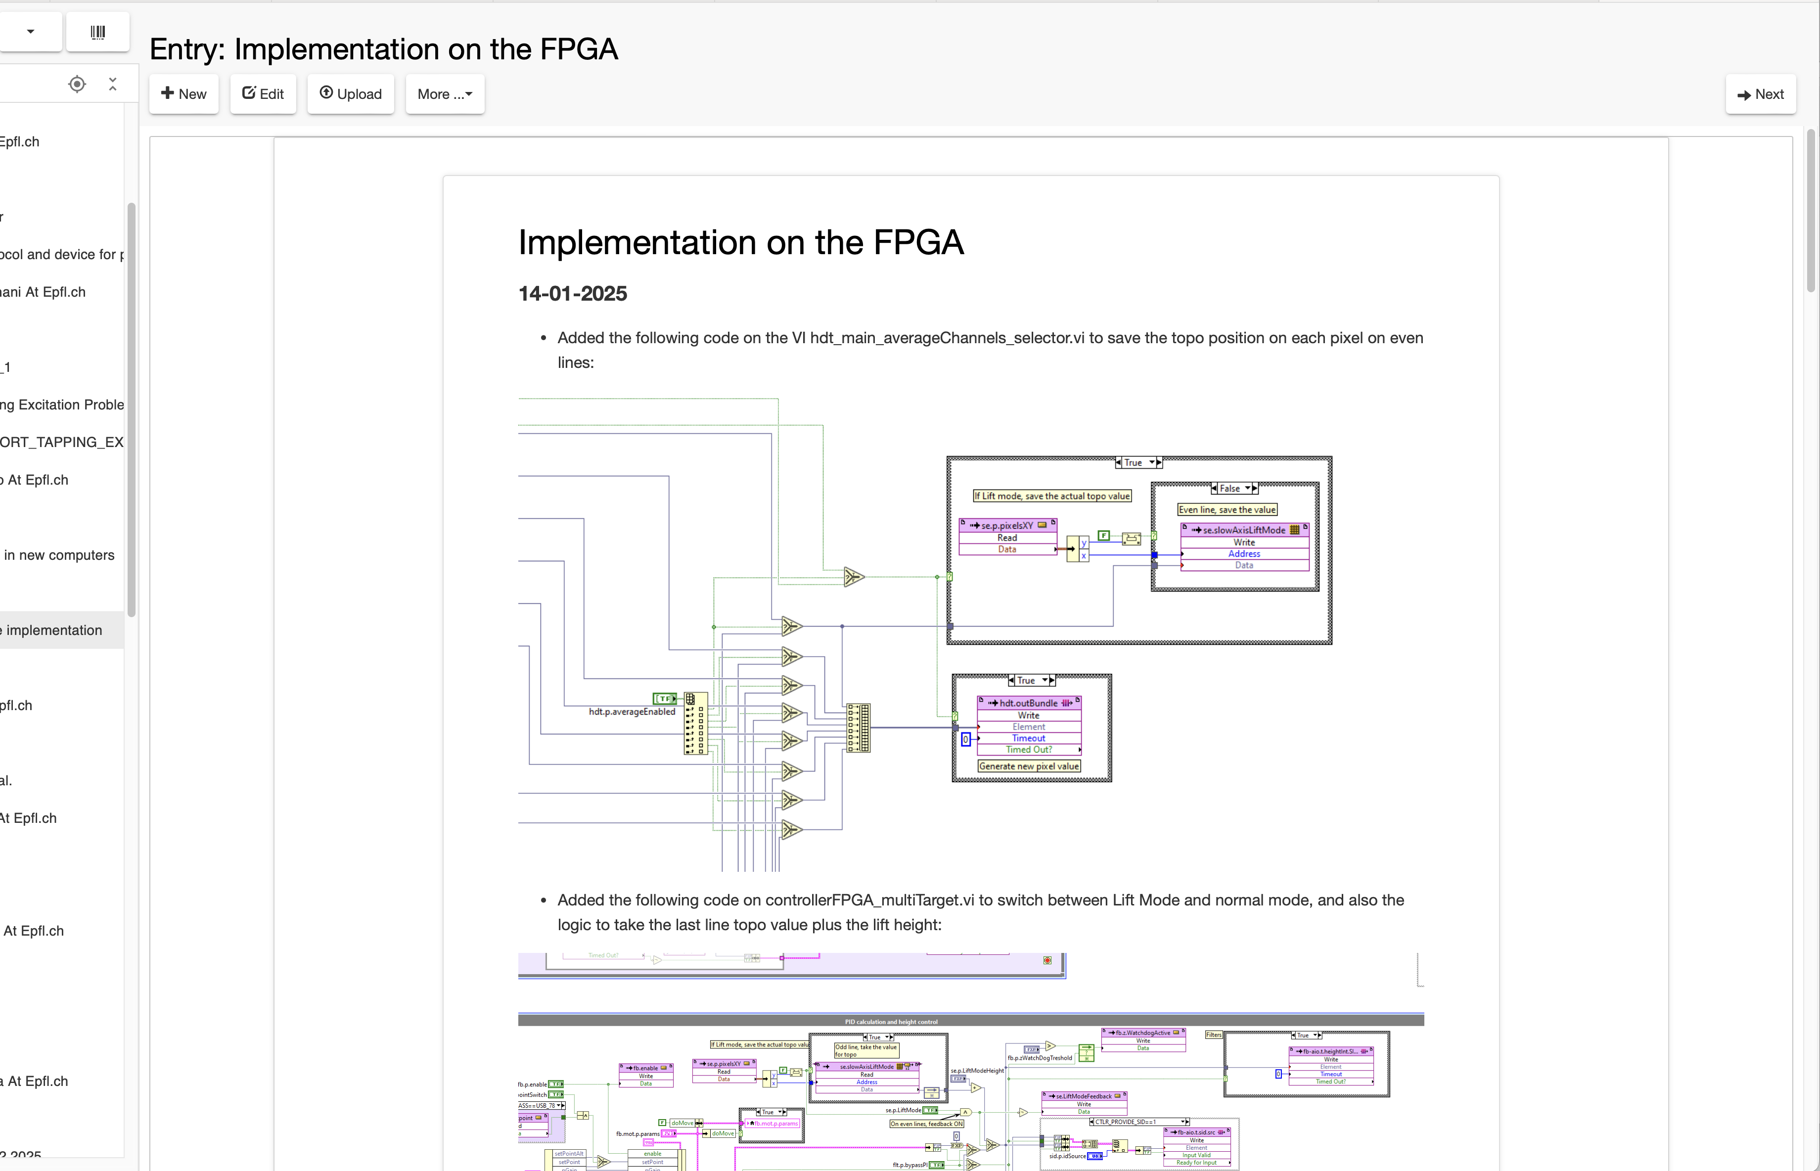
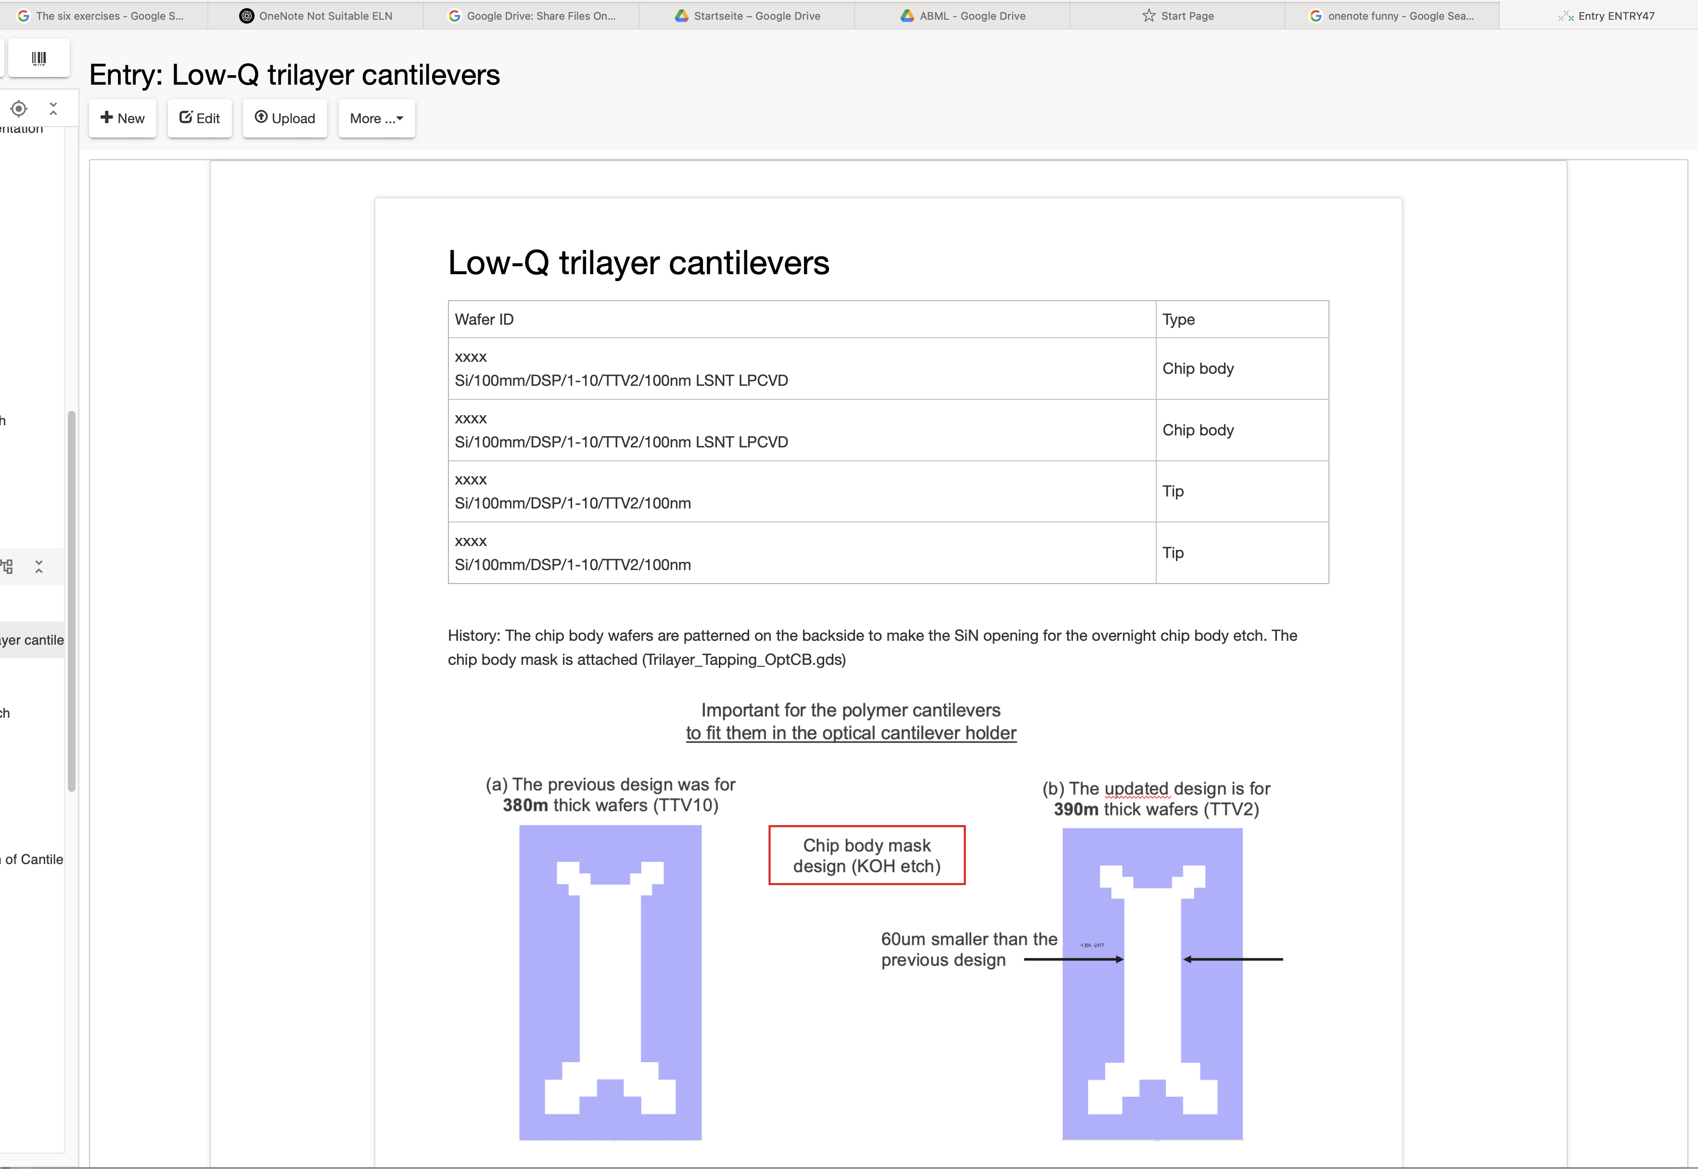
OpenBIS as an example for an ELN

